Slide 1
LOOK BENEATH THE SURFACE
Presented by
Dr. Clarence Greene

Slide 2
Human trafficking is a modern form of slavery. It involves controlling a person through force, fraud or coercion to exploit the victim for forced labour, sexual exploitation or both.
HUMAN TRAFFICKING

Slide 3
There are different types of human trafficking. (1) Sex Trafficking (2) Forced Labour (3) Domestic Servitude
HUMAN TRAFFICKING

Slide 7
Human Trafficking Is Everywhere

Slide 8
In the suburbs, In rural towns and in the cities

Slide 9
It can happen to anyone. No matter the race, the age or gender.

Slide 10
Every 40 second someone somewhere in the world is abducted

Slide 13
HUMAN TRAFFICKING
Human trafficking is a very
profitable crime.

Slide 14
HUMAN TRAFFICKING
Human trafficking is a very
profitable crime.

Slide 16
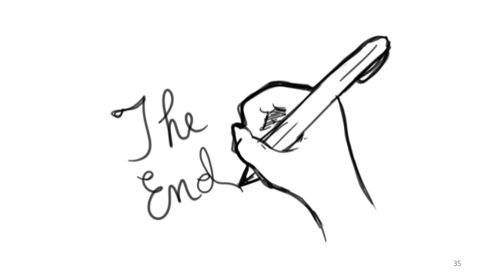
ICAN TALKS

Slide 17
ICAN TALKS
Training & Seminars http://clarencearchibaldnetwork.org
Marcia Henry: +44 7940 029902 UK
Office: +44 07547 502435 –UK
Phone:1-678-421-4855 -US
Whatsapp: 1-868-397-5961

